Slide 1
Keeping your body and brain active during lockdown!

Slide 2
Staying engaged with friends during lockdown!
Sign up to some free apps that get your friends together in a time of fun!
https://www.independent.co.uk/extras/indybest/gadgets-tech/best-apps-to-play-with-friends-games-iphone-facebook-houseparty-online-coronavirus-a9436271.html

Slide 3
Video call a group of friends!
Set time aside each week to video call one or more friends

Slide 4
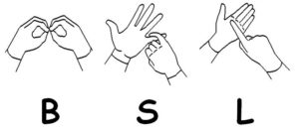
Learn a new skill!
Sign up to British Sign language lessons
Complete an online first aid course
https://www.sja.org.uk/get-advice/
https://www.british-sign.co.uk/
Learn a new language!
Sign up and enhance valuable life skills!
https://www.duolingo.com/learn
https://barclayslifeskills.com/young-people/

Slide 5
Work on your photography skills
Vlog your lockdown experience!
IMPROVE A HOBBY!
Remember, social distancing applies but you can still work on your sports skills with someone at home!
Create a new piece of art!

Slide 6
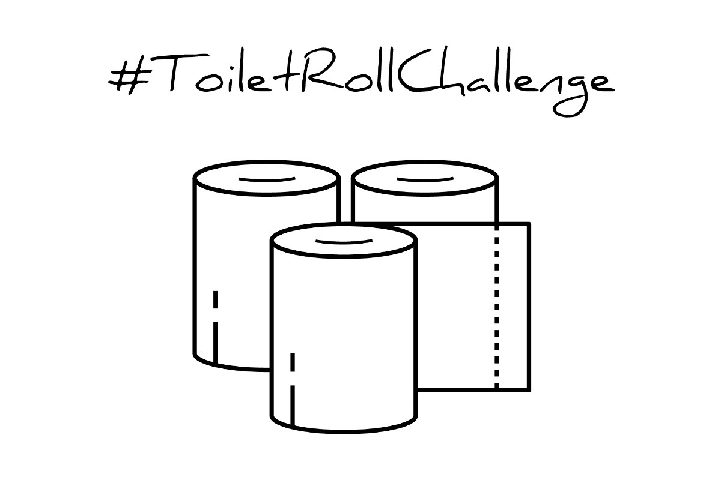
COMPLETE CHALLENGES!
See how many keepy uppy’s you can do in one go using only toilet roll. Be warned... It’s harder than you think!
Check out our social media pages for some fun challenges! KS – Technology have set up Ready, Kenny, Cook! Ken Stimpson Community School – PE set regular challenges including the #healthyselfie! Ken Stimpson Community School – Wellbeing Group has plenty of activity suggestions to keep you amused!
Set up a weekly Virtual Bake-Off with your friends! Decide on a theme for each week (e.g something chocolatey, something vegan, something savoury), set time aside for everyone to complete this task and take pics/videos of your journey to baking perfection!

Slide 7
COMPLETE CHALLENGES!
Decide on a book for you and your friends to read (there’s plenty of e-books to get your hands on!). Once you’ve all finished, create a quiz based on the book to see who really got in to it!
Dust off the puzzles that are hiding away in the attic and see if you can complete them all in record time!
Learn a new game! Create a ‘fun spot’ for your family each week so you can make new games / quizzes to challenge the whole family with! Give them a prize for after lockdown to keep them motivated!

Slide 8
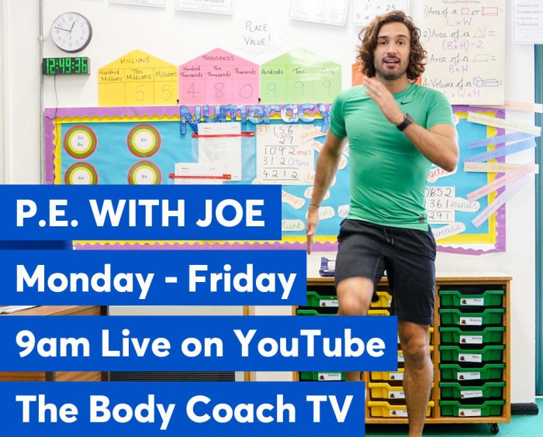
WELL-BEING ACTIVITIES
PE with Joe Wicks
https://www.youtube.com/channel/UCAxW1XT0iEJo0TYlRfn6rYQ
Dance with Darcie Bussell
https://www.youtube.com/watch?v=bMeZJqPCwoQ
Myleene’s Music Class
https://www.youtube.com/channel/UCQh2wgJ5tOrixYBn6jFXsXQ

